Slide 1
Team Shi
SudokuPlus

Slide 2
Team Members:
Mitchell Baer – Logic/Unit Testing
Matt Dean-Hall - GUI
Eric Celerin – Server/User Thread/GUI

Slide 3
Sprint 1:

Slide 4
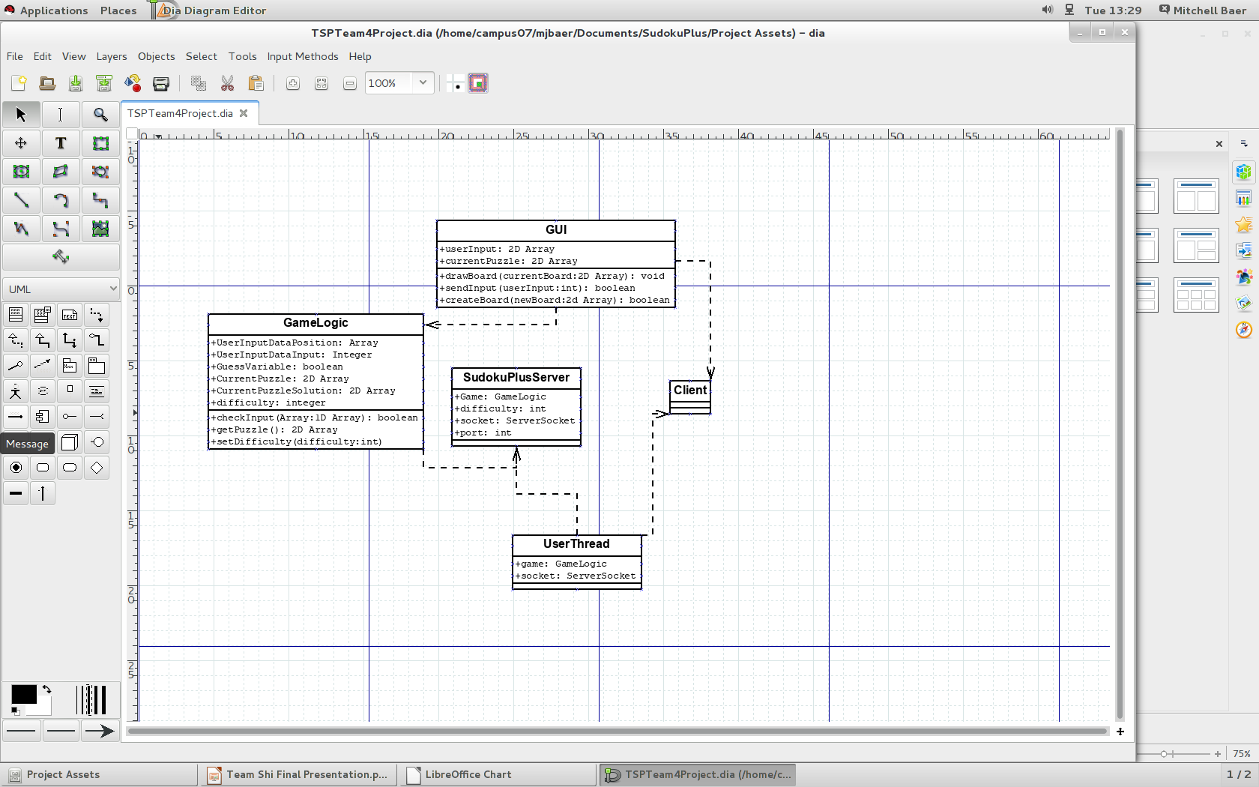

Slide 5
Good:
Developed a good plan (Diagrams)
Finished all of base code (GameLogic)

Slide 6
Bad:
Github – One member had experience
Timing – Didn't dedicate very much time towards actual programming.
Minor bugs to work through with getting everyone's code working together

Slide 7
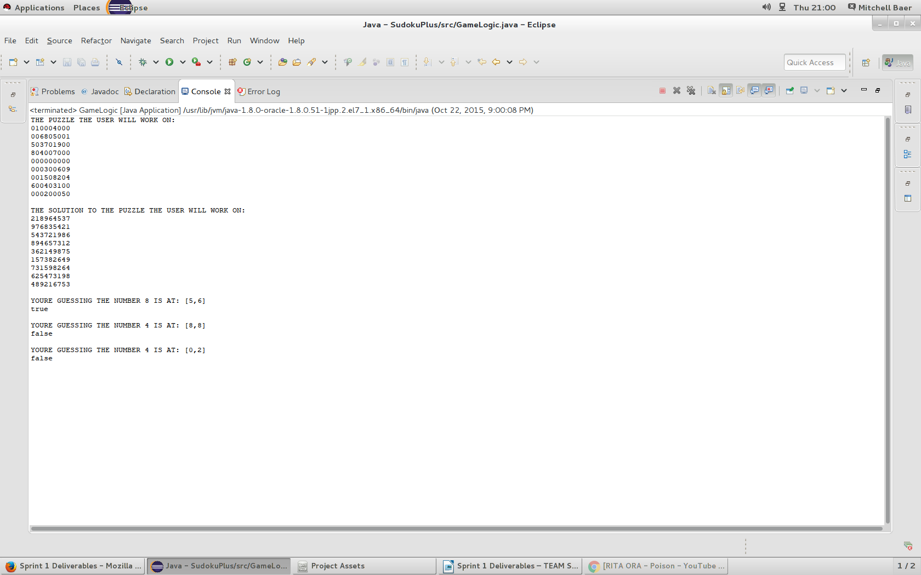

Slide 8
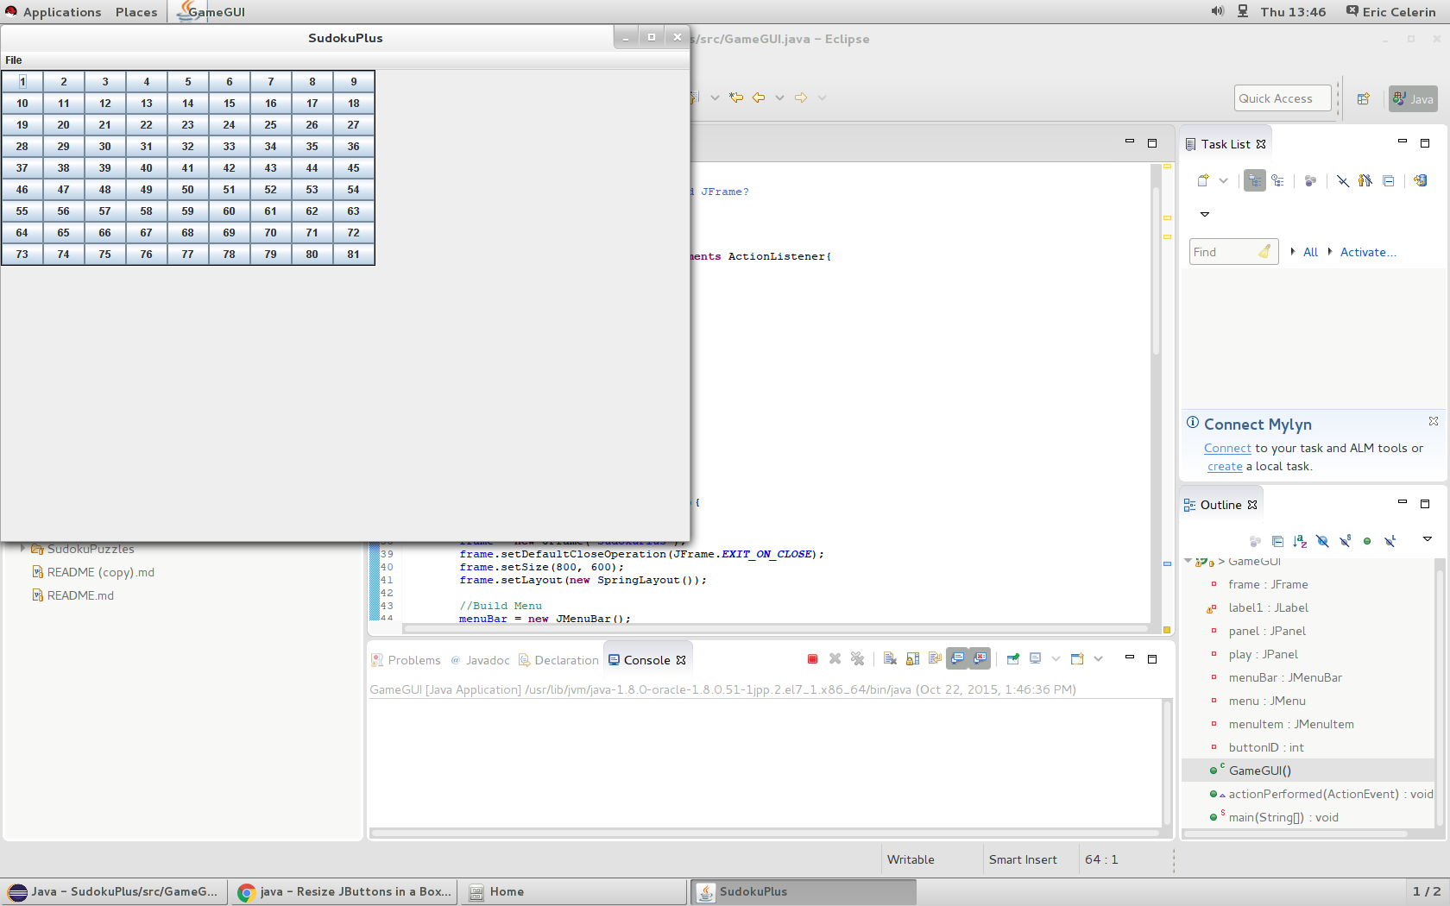

Slide 10
Sprint 2:

Slide 11
Good:

Slide 12
Bad:

Slide 13
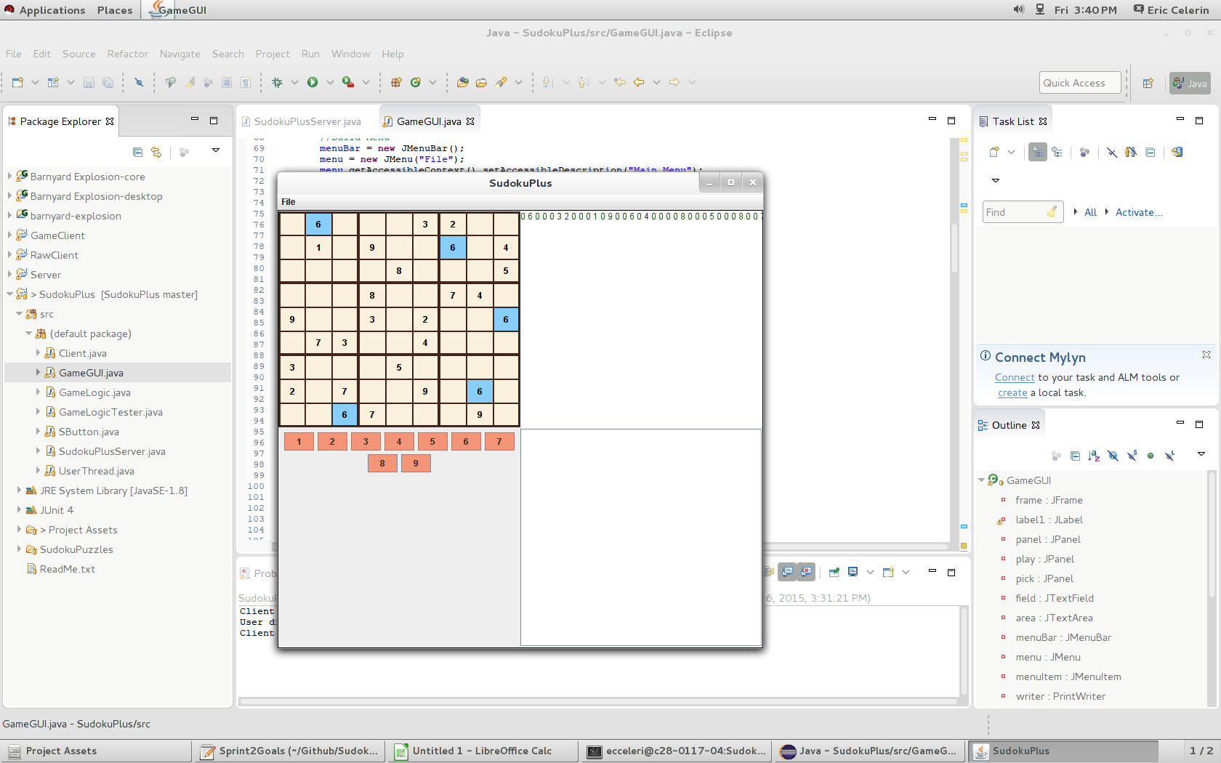

Slide 14
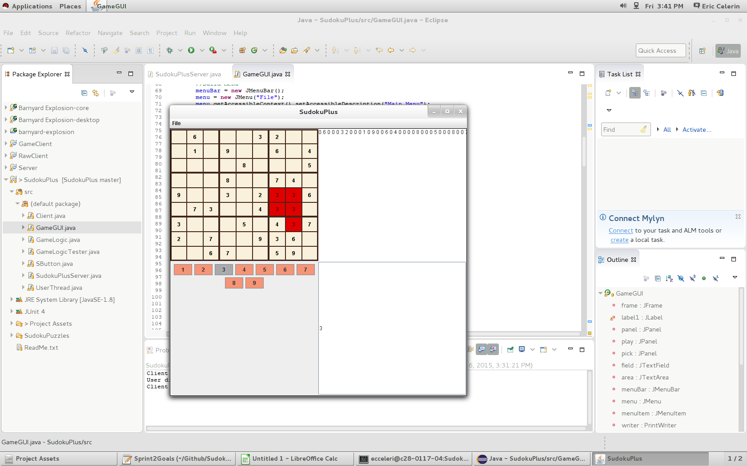

Slide 15
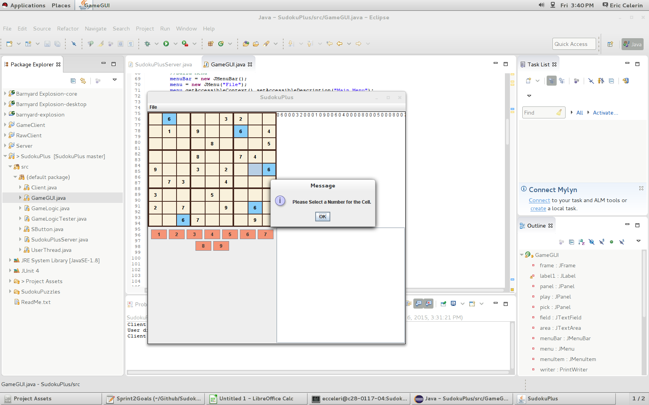

Slide 17
Unit Tests (JUnit)

Slide 18
Sprint 3:

Slide 19
Good:

Slide 20
Bad:

Slide 21
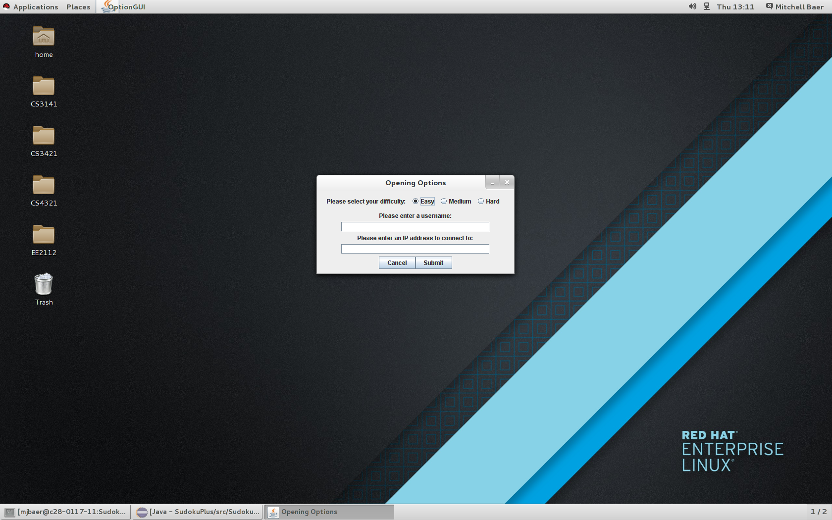

Slide 22
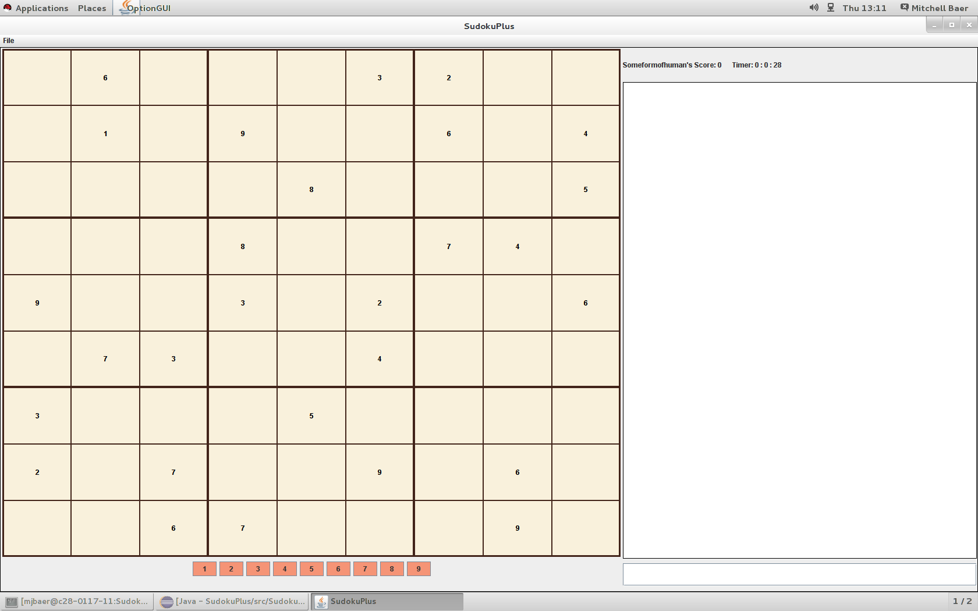

Slide 23
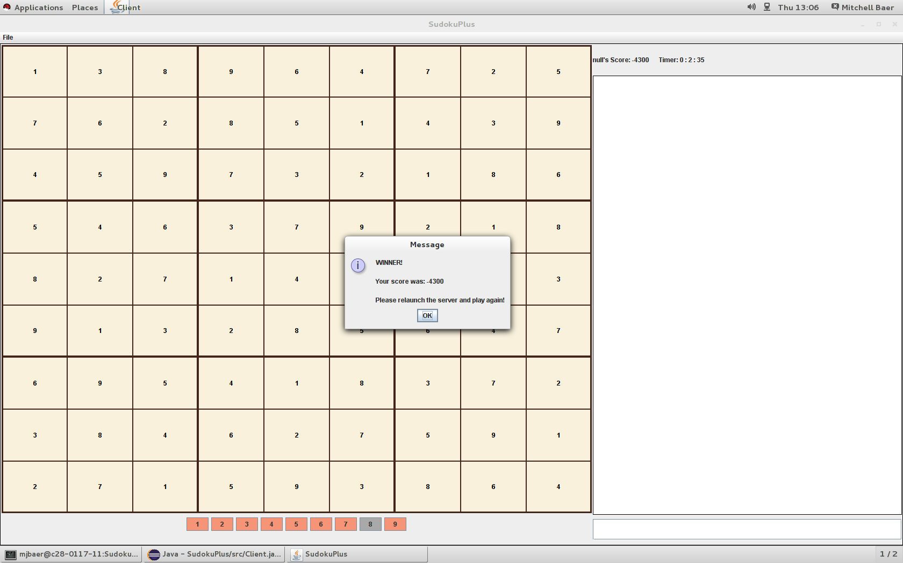

Slide 25
Difficulties Along The Way

Slide 26
Bugs

Slide 27
Cool Features

Slide 28
Finished Product Demo

Slide 29
Scrum

